Slide 1
Effort Reporting System
Effort Certification (ER)
Commitment Module
Faculty Assignment Report (FAR)
Donna Dyer, College Effort Coordinator
Office of Budget and Finance
352-273-3592 / dkb@ufl.edu

Slide 2
Presentation overview
Effort Reporting
Why is it important?
How does it impact you?
The New Effort Reporting System
Roles: Staff vs. Faculty
Faculty Assignment Reports (FAR)
Effort Commitments (CM)
Effort Certifications (ER)
Tips to maximize accuracy and minimize corrections

Slide 3
Why is Effort Reporting important?
A Gainesville Sun headline reported,
“UF will repay $192,000 over mishandled grants”
Published: Gainesville Sun
Tuesday, September 20, 2011
Nathan Crabbe, Staff writer
This article cited, in addition to other practices, misappropriation of effort; repercussions were fines, loss of grant dollars, and employment termination
Notes:
Currently, UF has several agencies on campus working with Cost Analysis, specifically reviewing effort reporting.

Slide 4
HOW DOES THIS IMPACT You?
Effort Reporting
UF receives federally-sponsored projects.
Compliance with OMB Circular A-21 guidelines. http://www.fa.ufl.edu/costanalysis/charging-costs.asp
http://www.whitehouse.gov/omb/circulars_a021_2004
Effort Reporting is the method by which UF honors and accounts for agency commitments.
New online FAR reporting process.
New online Effort Certification process.

Slide 5
Effort Certification (ER)
Commitment Module
Faculty Assignment Report (FAR)
Online Faculty Assignment Reports (FAR) replace paper Semester Assignment Reports (SFAR); mandatory FAR Summer 2012; Effort Certifications (ER) Summer 2011
FAR remains the initial step in allocating Faculty planned effort
FAR’s are generated, edited, and approved/acknowledged at the beginning of a semester; planned FAR effort is populated in the Effort Certification (ER) module at the end of a semester

Slide 6
Roles: Staff vs. Faculty FAR
Staff Role
Faculty Role
FAR Initiator
Security Role (UF_ET_FAR_INITIATOR)
Prepare online draft FAR
Tool availability for FAR
Course Schedule
GIMS (Graduate Info. Mgt. System)
CRIS Reporting (http://cris.nifa.usda.gov/)
Active Grants per P.I.
And, of course, the PI
Advance FARs for Approval
Unit Leader (Chair/Center Director)
Security Role (UF_ET_FAR_APPROVER)
Unit leader approval
Faculty Acknowledges assigned planned effort
No security role for PI
Email notification
Changes needed, FAR denied to FAR Initiator for corrections.
Expectation that Unit Leader and PI discuss planned effort and provide to FAR Initiator

Slide 7
Lifecycle of a FAR
Unit Leader and PI discuss planned effort
Planned effort is input on FAR by
FAR Initiator
FAR Initiator works with Unit Leader & PI to address any FAR errors
FAR Initiator submits to Unit Leader for final approval
Faculty will receive electronic notification to acknowledge FAR
When acknowledged YOU’RE DONE!

Slide 8
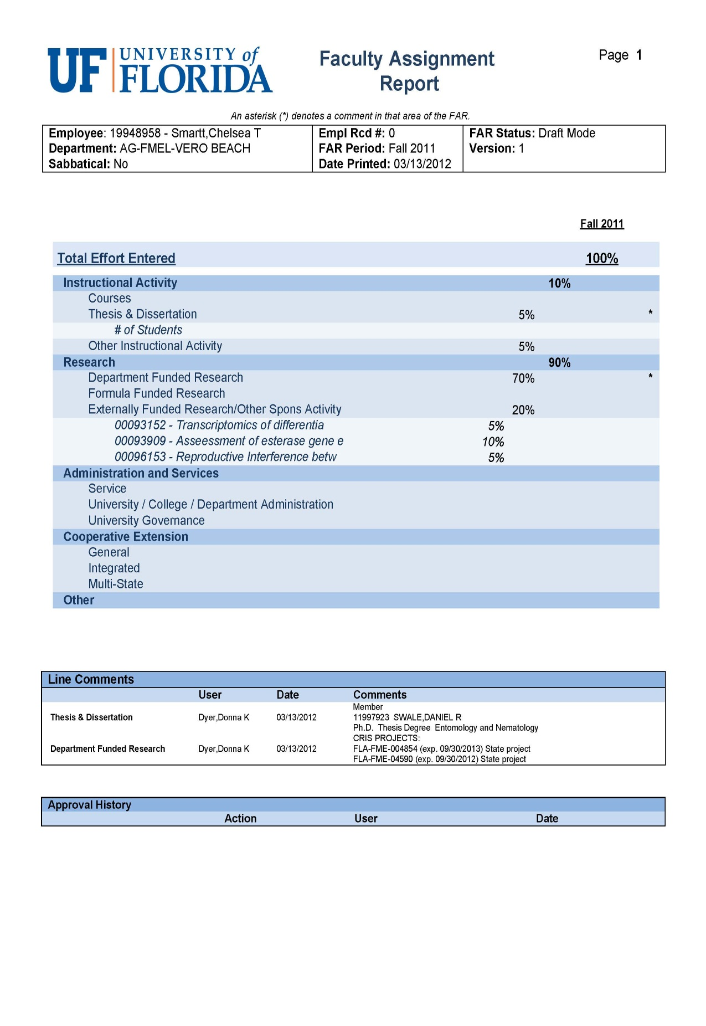
% to be used on ER for Grad I/II effort
commitments load from Commitment Module (CM)

Slide 9
Questions on the FAR?

Slide 10
Effort Certification (ER)
Commitment Module
(CM)
Faculty Assignment Report (FAR)
Designed to capture formal cost-share or direct-charge commitments
Driven by project team members: PI, Co-PI, and key personnel named by name or position
Any personnel to meet cost share must be loaded in the CM to capture the cost share
All commitments load automatically on the FAR and ER
Commitment Collection Form (CCF) used to enter cost-share or direct-charge
Typically, unit grants manager completes the CCF

Slide 12
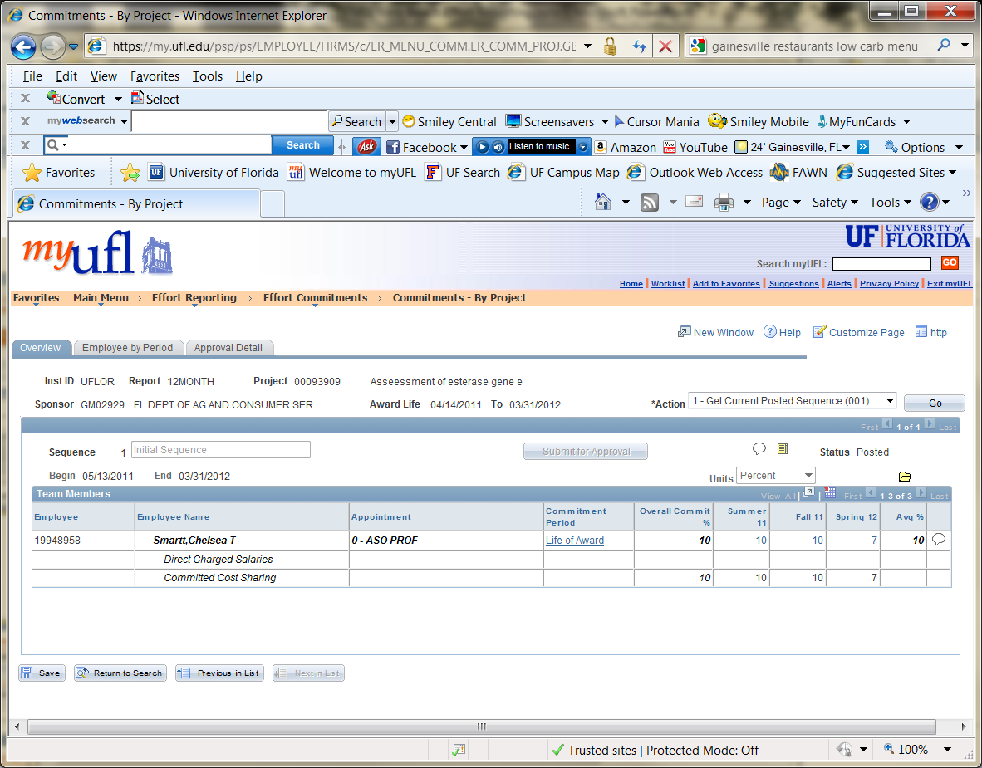
FAR Initiator can adjust individual terms; overall changes must be entered by C&G

Slide 13
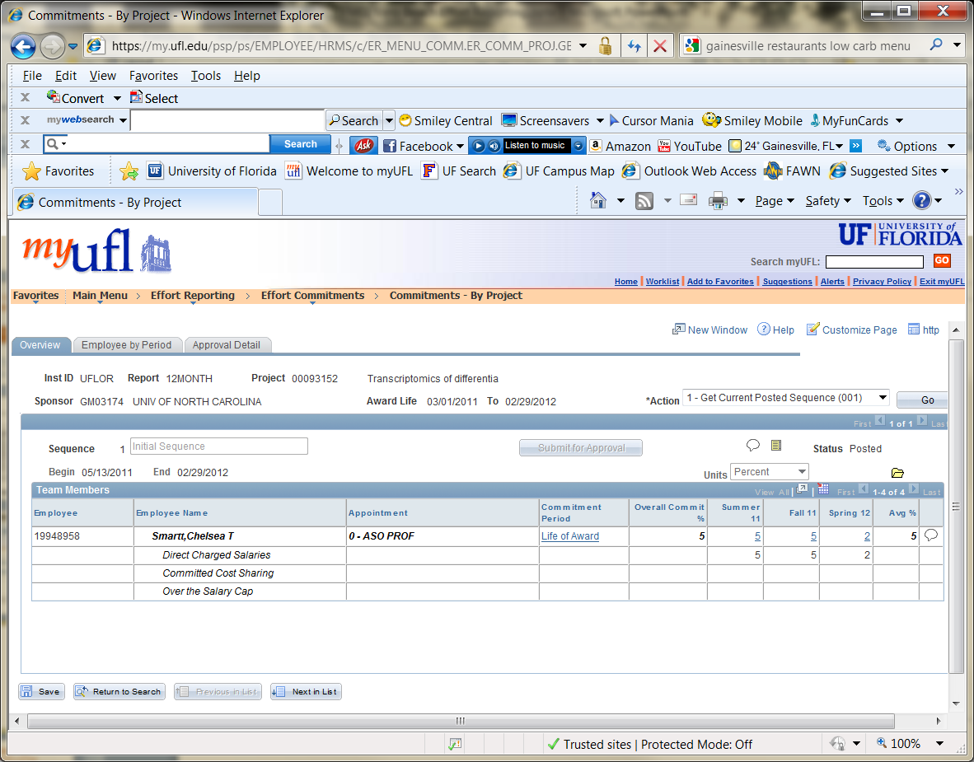
FAR Initiator can adjust individual terms; overall changes must be entered by C&G

Slide 14
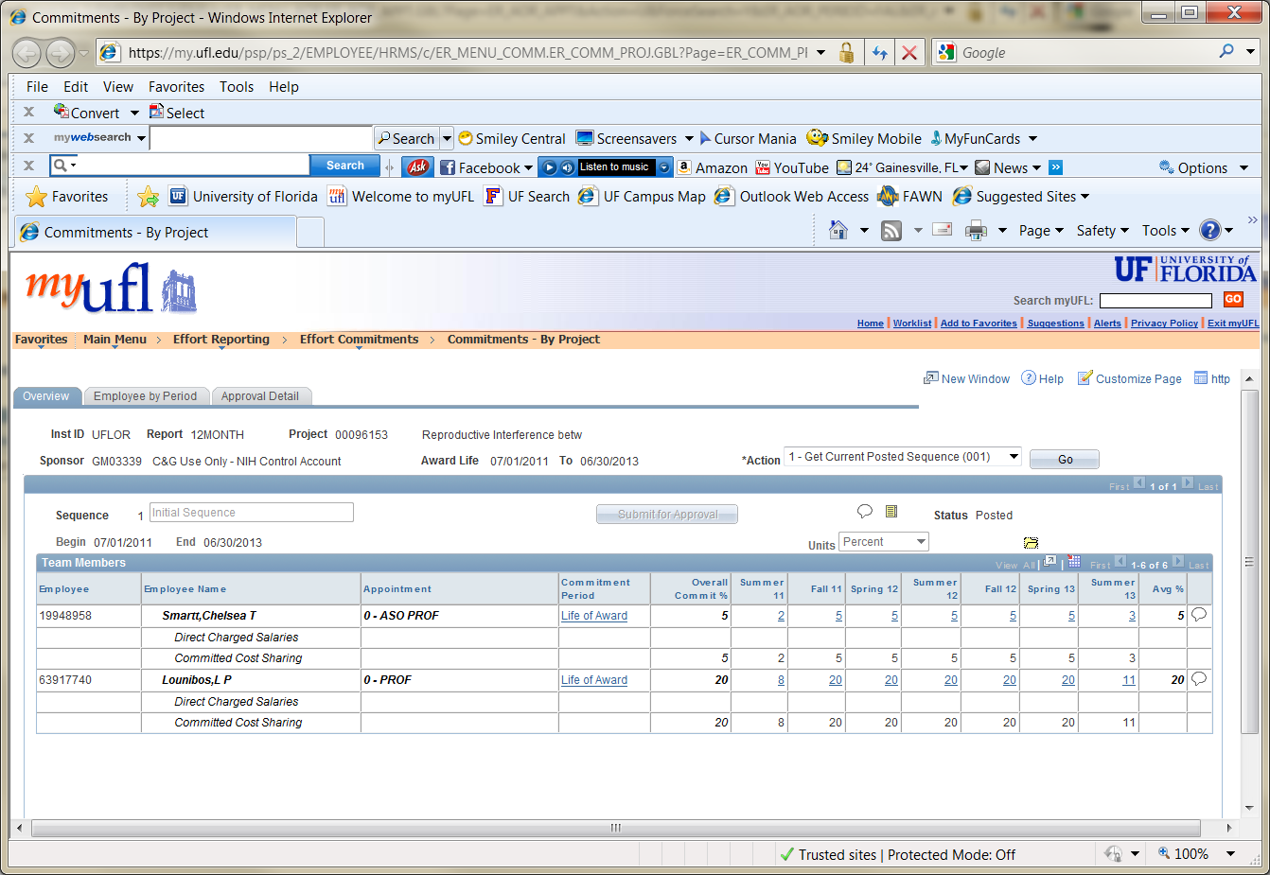
FAR Initiator can adjust individual terms; overall changes must be entered by C&G

Slide 15
Questions on the Commitment Module?

Slide 16
Effort Certification (ER)
Commitment Module
(CM)
Faculty Assignment Report (FAR)
Final step in Effort Reporting
Effort report is the auditable record to agency

Slide 17
Roles: Staff vs. Faculty Effort Report
Staff Role
Faculty Role
Effort Coordinator
Security Role (UF_ET_EFFORT_COORDINATOR)
Prepare (spread) effort
Effort will transfer FAR to ER
ER submitted for certification
Faculty = Cert_Employee path
Employees =Cert_PI path
Approved by grant PI
Faculty PI reviews, amends, or approves
Email notification
No security role for PI
PI has the ability to amend % effort
Unless changes entered by PI require action or exceed tolerance levels, ER advances to Cost Analysis and closes overnight.
(NOTE: Unit Leader does not have review/approval role in the certification process)
Cert_Employee path will have a conflict of interest statement to be answered.

Slide 18
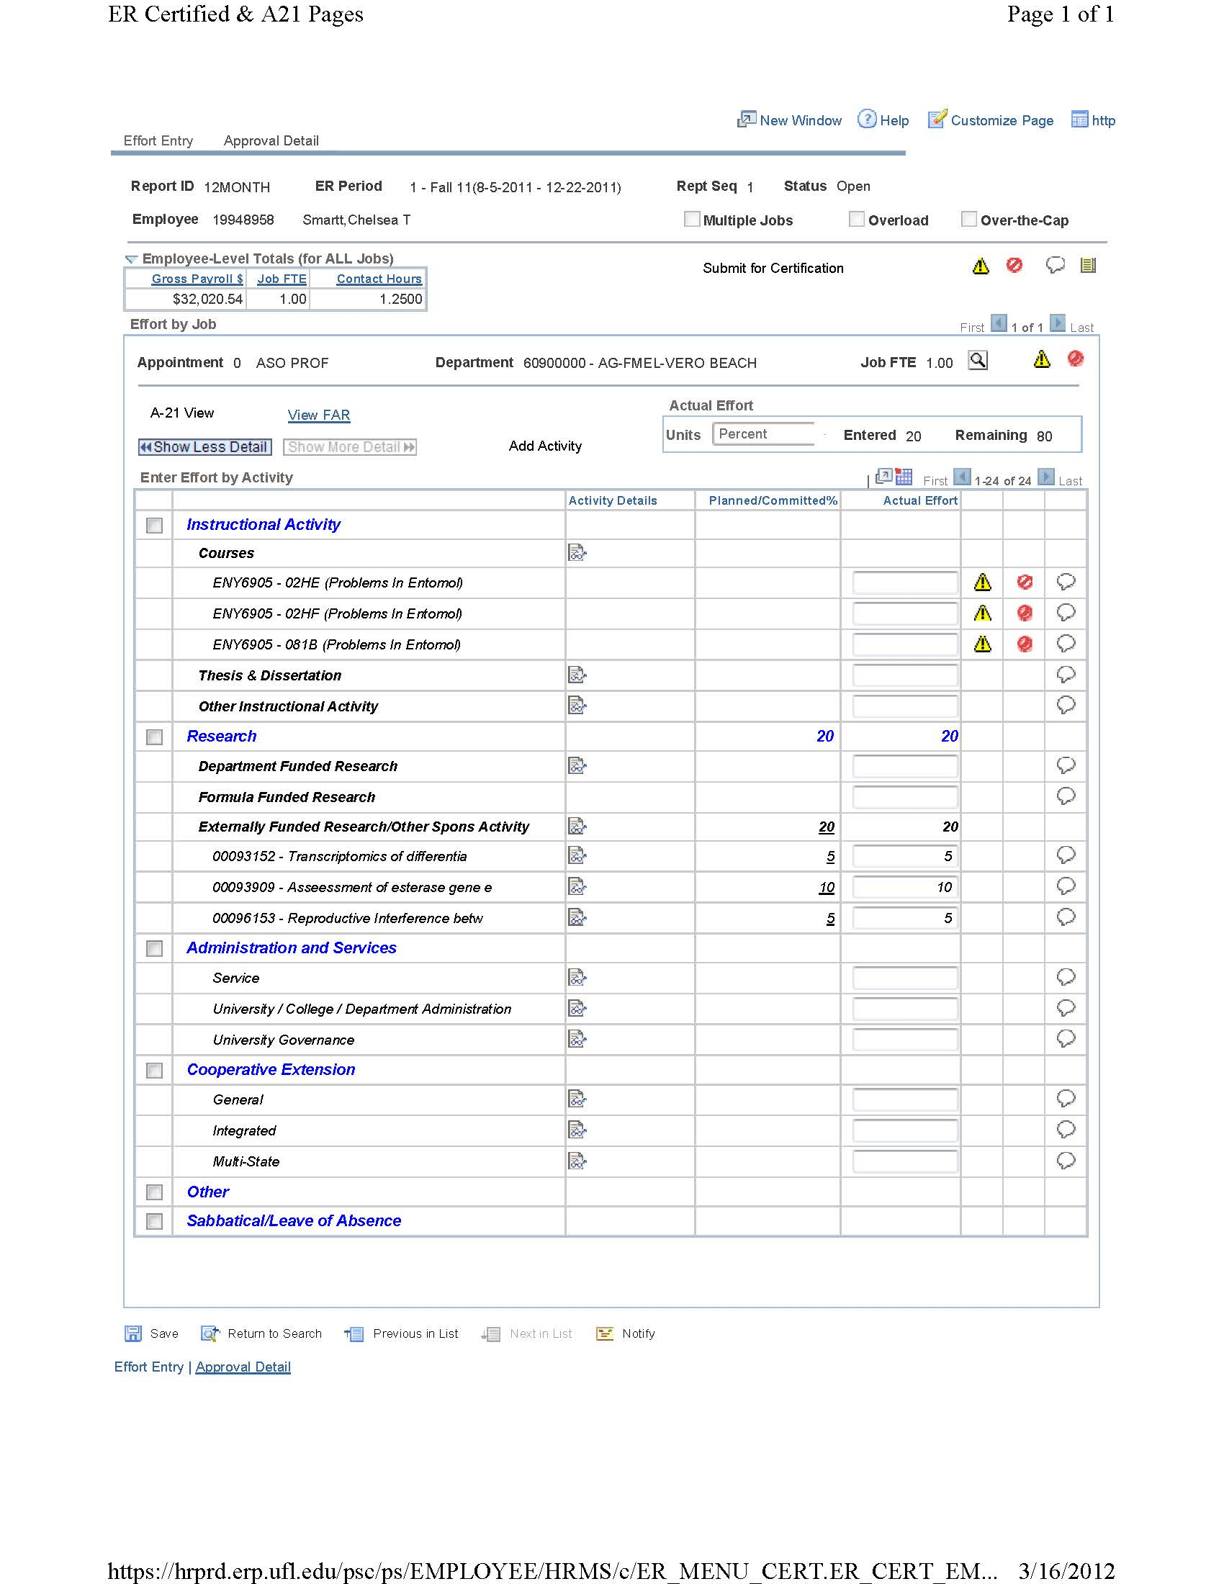
Effort Report Before Spread

Slide 19
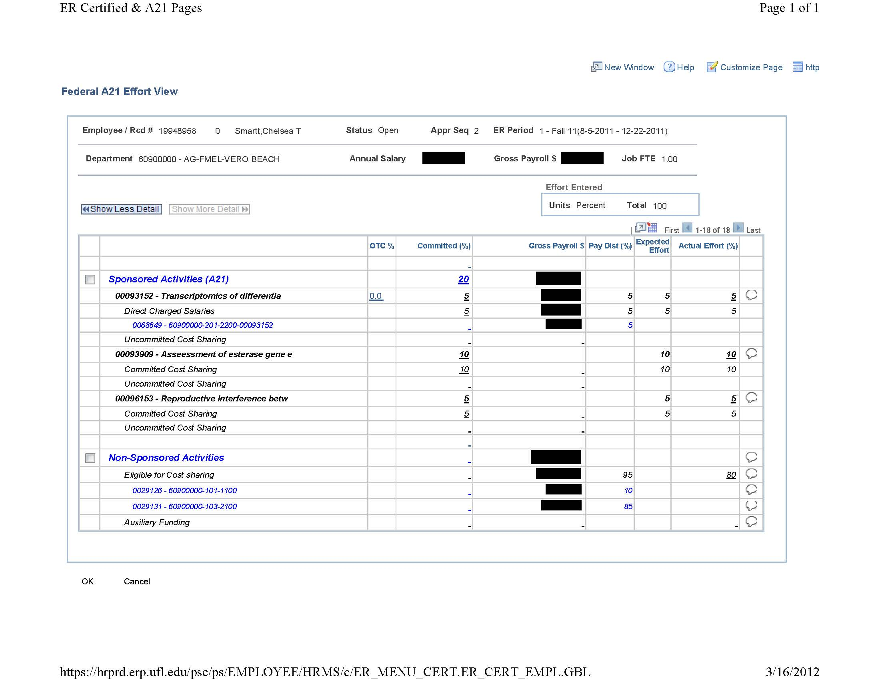
Effort Report
A21 View

Slide 20
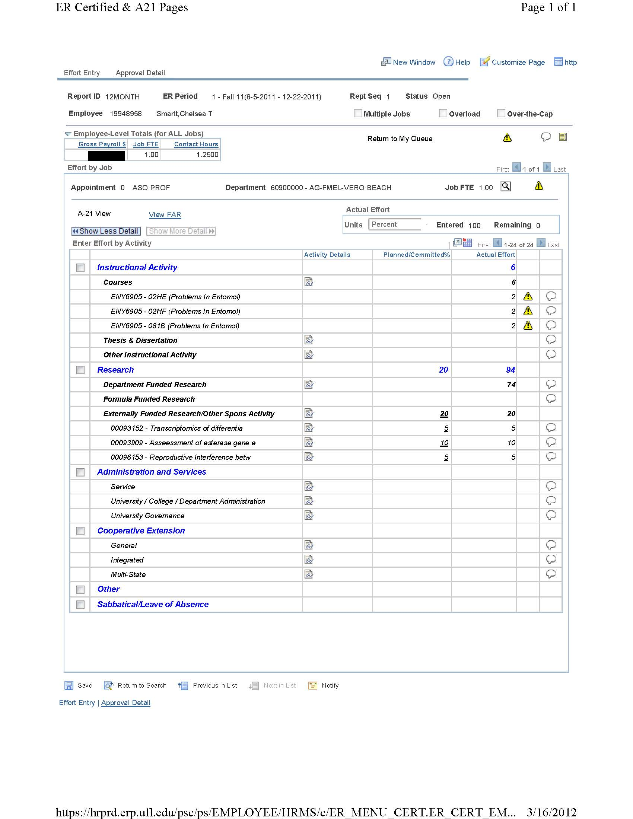
Effort Report AFTER Spread

Slide 21
Lifecycle of EFFORT CERT
PI reviews; if changes needed PI can change % effort or deny it to EFF CRD for changes
PI approves Effort Report
Note: PI will have to check box agreeing to verifiable means
Effort Certification is complete and should archive automatically to Cost Analysis
YOU’RE DONE!
EFF CRD advances the Effort Cert to PI for certification
PI works closely with Effort Coordinator (EFF CRD) to address any errors

Slide 22
Questions on the Effort Report?

Slide 23
Let’s take a look at Effort Certification emails

Slide 24
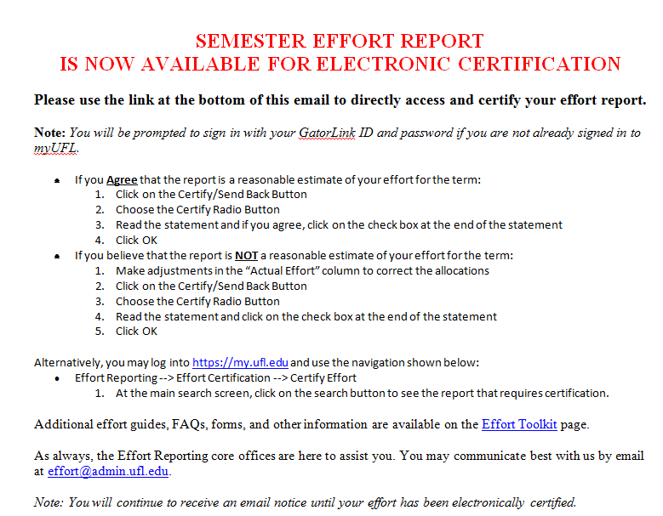

Slide 25
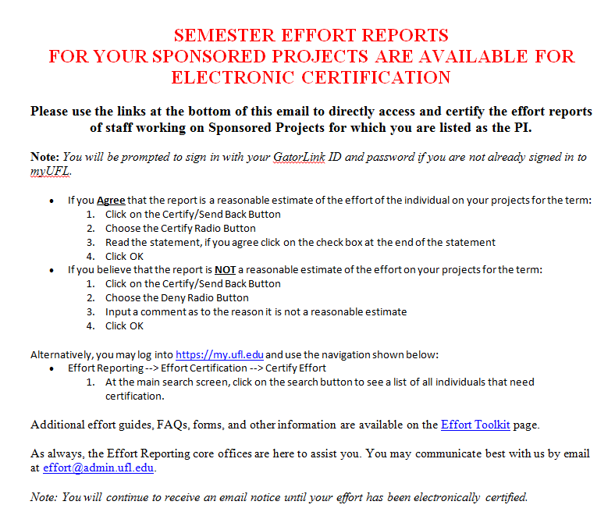

Slide 26
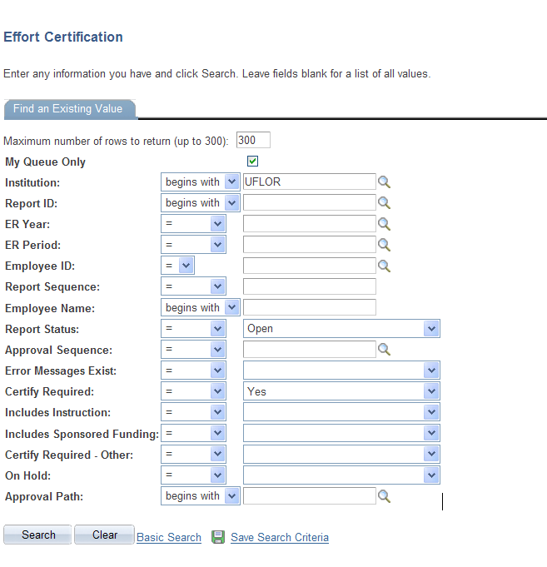
ER PERIOD
Fall = 1
Spring = 2
Summer = 3

Slide 27
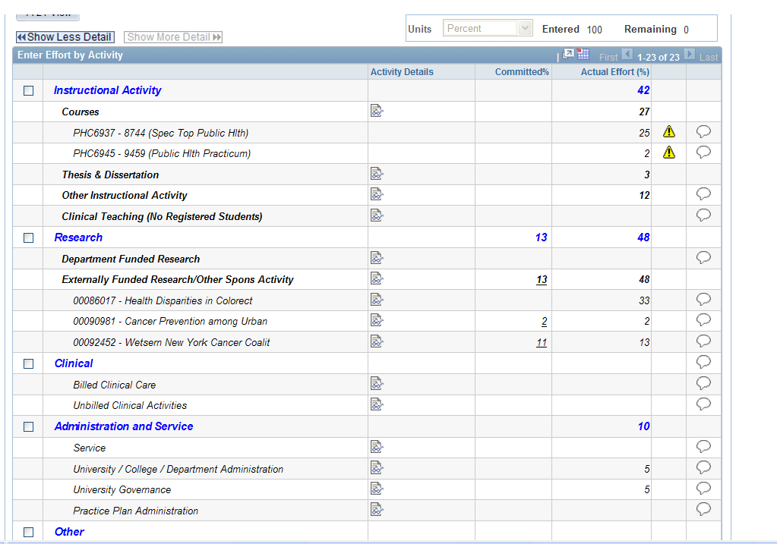
Faculty / PI Certification

Slide 28
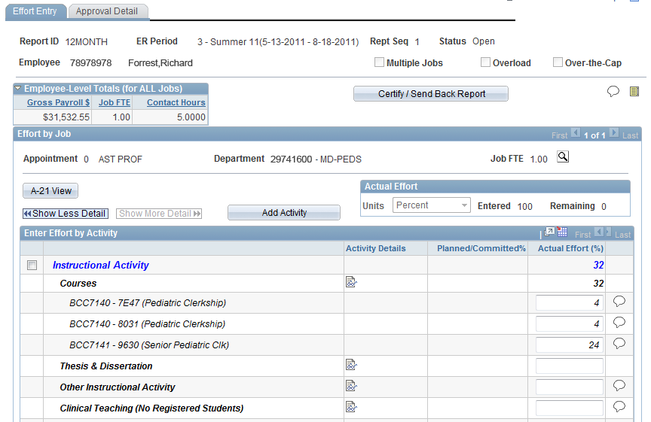
Faculty / PI Certification

Slide 29
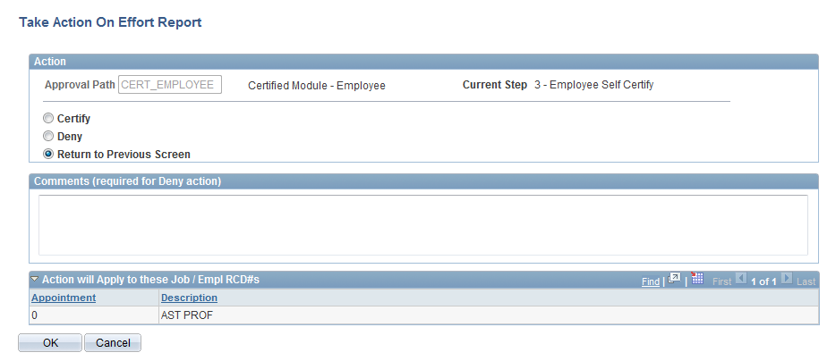
Faculty / PI Certification
You have a choice, to either certify the record, or deny back to me for adjustments

Slide 30
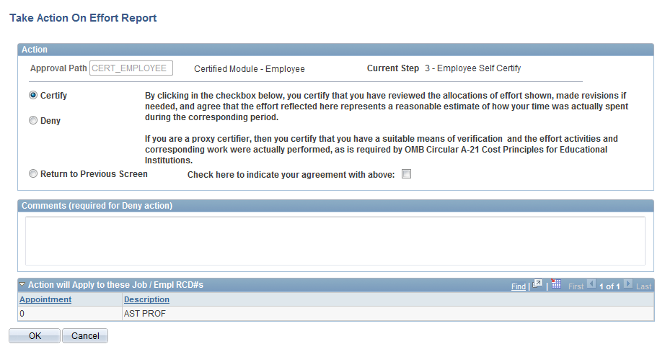
Faculty / PI Certification

Slide 31
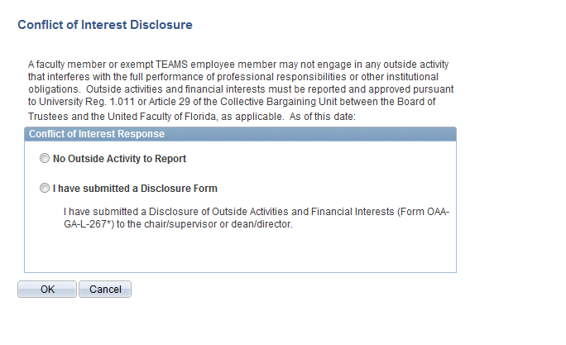
Faculty / PI Certification

Slide 32
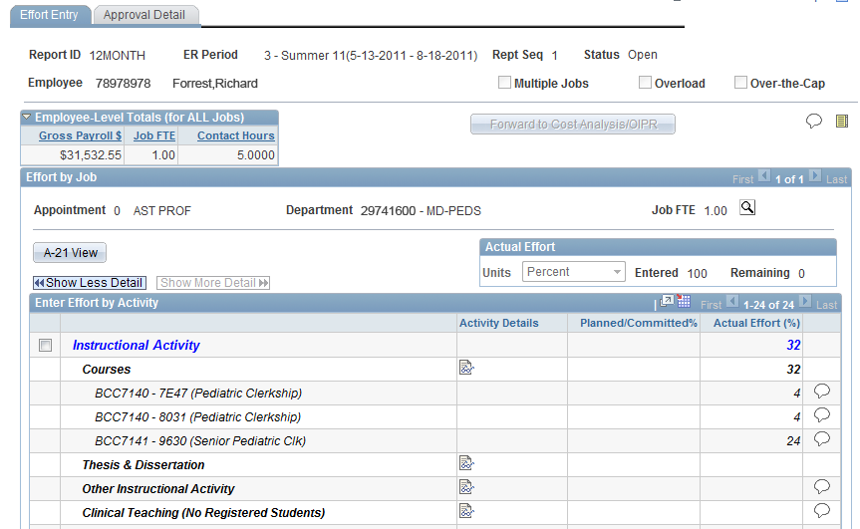
Faculty / PI Certification
Certification Complete

Slide 33
Q & A

Slide 34
How TO Maximize ACCURACY and MINIMIZE CORRECTIONS
Each semester, review teaching activities
Ensure course activity is reported in the Instructor Workload (IWF)
Review committee assignments for thesis & dissertation reporting

Slide 35
How TO Maximize ACCURACY and MINIMIZE CORRECTIONS
Each semester, work with your Grants Specialist to ensure current & new grants are reflecting correctly.
C&G Commitment Module is the repository of direct-charge and cost-share commitments
Commitments are person-specific. If you plan to change who or how formal commitments are met, you will need to submit Commitment Collection Forms to update the C&G Commitment Module
Make sure direct charges and cost sharing are recorded correctly in the commitment module

Slide 36
How TO Maximize ACCURACY and MINIMIZE CORRECTIONS
Each semester, work closely with your payroll liaison to enter direct-charge salaries accurately and timely.
Ensure you are not charging more salary to a grant than committed and approved by agency

Slide 37
How TO Maximize ACCURACY and MINIMIZE CORRECTIONS
General questions to ask for best reporting practices
Am I teaching courses this semester?
Do I have any committee assignments?
Do I have any grants?
Am I cost shared or do I need to pay direct-charged salaries?
Do I have any Formula Funding Effort?
CRIS projects that are Hatch, Multistate or McIntire Stennis, and should be reported under formula funding on the FAR/Effort Report.
Have I reported Extension activity correctly?
Extension effort for faculty with a Research and Extension assignment is considered integrated.

Slide 38
How TO Maximize ACCURACY and MINIMIZE CORRECTIONS
Notes of Importance:
The accuracy of the FAR greatly impacts the ease of completing Effort Certification.
If discrepancies on the FAR are allowed to roll forward to the Effort Certification, more work will be required to correct discrepancies.
It is highly advantageous to place emphasis on accurate reporting of assignments on the FAR, rather than reactive corrections on the ER!

Slide 39
Additional Assistance:
Thank you for attending.
Please contact appropriate staff should you have additional questions.
Donna Dyer, Effort Coordinator
UF/IFAS, Budget and Finance
273-3592 / dkb@ufl.edu
Brenda Harrell, Manager
UF Cost Analysis
392-5778 / bbh@ufl.edu
Armando Ramirez, Policy and Planning Analyst
UF Office of Institutional Planning and Research
392-0456, ext 219 / aramire@ufl.edu

