Slide 1
Faculty Salary Saving Program (FSSP)
Presented by
Palvi Sharma, IFAS Budget Office
Elisa Duvall, IFAS Budget Office
Belinda Scurlock, IFAS Budget Office

Slide 2
What is FSSP?
IFAS has established a Faculty Salary Savings Program to return state salary savings to faculty members who have salary charged/distributed on extramural funds. The savings would be returned to 9-month faculty as potential summer salary and to 12-month faculty as program funds in OPS and/or operating dollars the next fiscal year.
*State salary is made up of funds 101, 103, 107,108

Slide 3
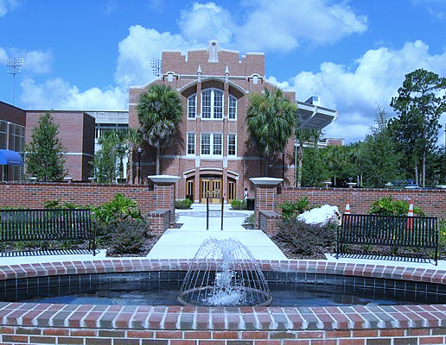
Participation is strictly voluntary.
Consult your department about enrollment
Effort reporting and cost-sharing obligations must be considered and addressed.
Faculty members are expected to maintain or enhance their historic performance. For example, the number of graduate students supported and mentored, extension educational programs conducted, and number of courses taught should be maintained or enhanced.
FSSP applications are only accepted for up to a single year, in advance of the term. If the award is multi-year, the PI must reapply for the FSSP covering the new fiscal year. No retroactive applications will be accepted.

Slide 4
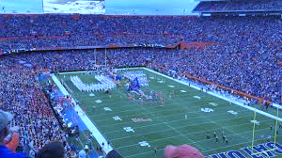
Submission :
12-month faculty- Submit the form at the beginning of the fiscal year. Please update the budget office with any changes in the FSSP project during the year.
9-month faculty- Submit the form at the beginning of Fall semester. Actuals and estimated projections, will be sent to each faculty at the end of spring term, so they can determine their summer salary appointment to be paid with these savings.
Returns:
12-month faculty- After payroll is completed for the last pay period of the fiscal year, we will run the cost distribution reports, pivot and send the notification of the salary savings to the faculty. 75% of the total Salary savings will be returned as program dollars allocated to OPS and/or Operating funds only, to be spent by the current fiscal year end.
9-month faculty- 75% of the total Salary savings will be returned as summer salary, unless requested otherwise. Any overage in excess of the Summer term will be returned as program dollars in September, allocated to OPS and/or Operating funds only

Slide 5
IFAS FACULTY SALARY SAVINGS PLAN APPLICATION FORM
NAME |  |  |  |  |  |  | UFID
TITLE |  |  |  |  |  |  | UNIT
PROPOSED DURATION: |  |  |  | 9-Month Faculty:
List project funding source(s) for non-state funds. UF Foundation/SHARE and Faculty Service Program funds are not eligible for this program. Please indicate project number(s), dates and percentage of distribution.
Project # |  |  | Dates |  |  | Distribution percentage |  |  | Funding Source
The faculty member's signature verifies agreement to the following statements and is required prior to the implementation of a FSSP:
*Participation is strictly voluntary.
*Effort reporting and cost-sharing obligations must be considered and addressed.
*Faculty members are expected to maintain or enhance their historic performance. For example, the number of graduate students supported and mentored, extension educational programs conducted, and number and quality of courses taught should be maintained or enhanced.
*FSSP applications are only accepted for up to a single year, in advance of the term. If the award is multi-year, the PI must reapply for the FSSP covering the new fiscal year. No retroactive applications will be accepted.
*For 9-month faculty, 75% of your salary savings will be returned as summer salary, unless requested otherwise. Any overage in excess of a summer term will be returned as program dollars in September. For 12-month faculty, 75% of your all salary savings will be returned as program dollars, to be spent by the fiscal year end.
*No distribution less than $1000 will be made or carried forward.
* Distributions of the salary savings will be made in May for 9-month faculty to extend the full summer term and in August for 12-month faculty.
* Payroll distributions to the relevant projects are the department's responsibility.
Unit Grants Manager Contact Information (name & phone & email)
Faculty Member (signature and date)
Approved: Department Chair/REC Director
FSSP FORM

Slide 6
Questions?

